Slide 1

Fairness of Exposure in Rankings
Ashudeep Singh
Cornell University
Thorsten Joachims
Cornell University
Shivangi Bithel
IIT Delhi
Notes:
Good Afternoon everyone, I am Shivangi and today I am going to present the paper Fairness of Exposure in Rankings as part of COL 873.

Slide 2
Presentation Overview
Background
Ranking task
Paper motivation
Related work
Framework for ranking under fairness constraints
Three group fairness constraints
Discussions
Conclusions
Questions
Reviews
Notes:
This is the overview of my presentation.

Slide 3
Background
Discounted Cumulative Gain:
Highly relevant documents are more useful if appearing earlier in search result.
Highly relevant documents are more useful than marginally relevant documents which are better than non-relevant documents.
Probability Ranking Principle: According to PRP, ideal ranking should order items in the decreasing order of their probability of relevance.
Notes:
First we will discuss some required background
We all are aware of Discounted Cumulative Gain.
DCG is used here to measure the effectiveness of the ranking algorithm. It is based on an underlying assumption that Highly relevant documents are more useful if appearing earlier in search result. And Highly relevant documents are more useful than marginally relevant documents which are better than non-relevant documents.
Probability ranking principle: According to PRP, ideal ranking should order items in the decreasing order of their probability of relevance.
With this age old notion of ranking, the items ranked using PRP are only focusing on the utility of the IR system. There are enough arguments that ranking systems in use today have responsibility not only to their users, but also to the items being ranked.

Slide 4
Birkhoff-von Neumann decomposition:
A doubly stochastic matrix is a matrix in which each row and each column sum to one. A permutation matrix is a matrix in which each entry is either zero or one.
By the Birkhoff–von Neumann Theorem, each doubly stochastic matrix is a convex combination of permutation matrices. In other words, for each N x N doubly stochastic matrix A, there exists a decomposition of the form
A = θ₁A₁ + θ₂A₂ + · · · + θ_{n}A_{n}, where 0 ≤ θi ≤ 1, Σ_{i}θ_{i} = 1 , and where the A_{i} are permutation matrices.
Notes:
(n-1)² +1

Slide 5
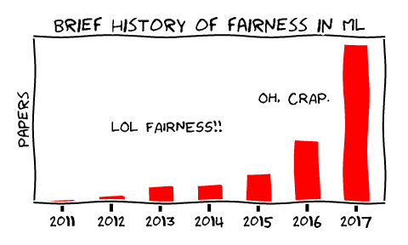
The number of publications on fairness from 2011 to 2017
A Tutorial on Fairness in Machine Learning | by Ziyuan Zhong
Notes:
Fairness is becoming one of the most popular topics in machine learning in recent years.
Publications explode in this field as we can see from this figure. There are large number of publications in 2017 as compared to 2011. The research community has invested a large amount of effort in this field.

Slide 6
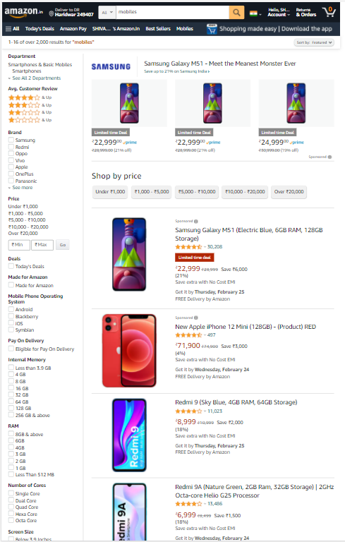


Ranking is Everywhere
Ranking is a dominant form of representation of information in the online web.
Search engines
Recommender systems (products, jobs, job seekers, friends on social media)
News feeds
Notes:
Ranking is Everywhere
It is a dominant form of representation of information in the online web.
search engine: this is the image from amazon.com, where the results are the relevant items ranked according to some algorithm when the query given is mobiles.
recommender system: This is the image from LinkedIN, showing the recommendation of jobs according to my profile
news feed: We see news feed in facebook, instagram, etc similarly here is the image from my youtube music news feed.
Most of the platforms are ranking the relevant items for us today..

Slide 7
Paper Motivation
We are not only ranking documents these days in web but also people, businesses, or places thus it has become more important now to have a fairness in ranking as any sort of bias can lead to loss of opportunity for the protected groups.
Notes:
We are not only ranking documents these days in web but also people, businesses, or places thus it has become more important now to have a fairness in ranking as any sort of bias can lead to loss of opportunity for the protected groups. People might not get job even if they are qualified which affects their career, Businesses might not get customers and thus affect their earnings, etc. Now we are going to see three scenarios where one might want to trade of utility for certain amount of fairness in ranking.

Slide 8

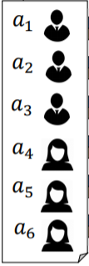
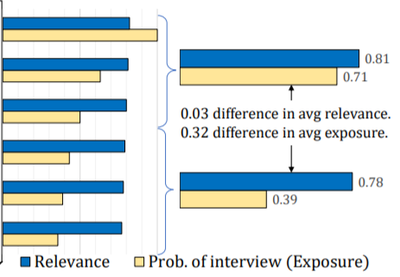
Fairly Allocating Economic Opportunity
According to the probability ranking principle
Exposure (Pos j) = 1 / Log (1+j)
A job applicant ranking system
Notes:
Here is an example of a job applicant ranking system. We have a set of 6 candidates who have applied for a certain job. There is a relevance score attached to each candidate which is the fraction of employers that might find the candidates relevant for that job. Now if we rank the candidates according to the probability ranking principle, focusing only on the utility of users, i.e. employers in this case, this is the order that we get. Now lets check the exposure that every candidate gets. Let’s say that the position bias of a position j is 1 divided by log of 1 + j. This is a standard position bias used in DCG. This means that the probability of a candidate being interviewed decreases as we go down the ranking. For this particular setup, the average exposure that the two groups get differs by about 0.32 while there is a difference of only 0.03 in the average relevance of the two groups. In other words, on average 32% less number of employers are likely to interview female candidates. There is a small difference only in the average relevance scores of the two groups but a large difference in opportunities that these groups are getting.

Slide 9
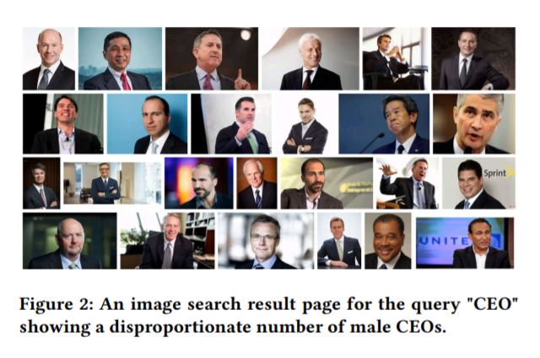
Fairly Representing a Distribution of Results
Notes:
The above image shows a hypothetical search result of CEOs from a search engine. The result is showing a highly disproportionate number of male and female CEOs, in such a case we can consider this search engine as biased. A biased information environment may affect users’ perceptions and behaviors, and it was shown that such biases indeed affect people’s belief about various occupations. As you can see there is not a single female CEO represented here, even though we accept the fact that the number of female CEOs are less than male ceos but the result should atleast show the correct distribution and not a biased one. Thus Probability Ranking Principle does not necessarily produce results that represent the relevance distribution in an unbiased way.

Slide 10
Giving Speakers Fair Access to Willing Listeners
Consider an example of times during election in a country. There are many people posting their opinions on social media websites like Twitter or Facebook. Everyone has a freedom to speech and thus can post both positive and negative feedbacks about any party standing in election.
But if a social media site is biased in its opinion towards one party that it might rank positive comments on top for one party and negative comments on top for other and this will influence a neutral person to also form a biased opinion during the election. The importance of equal exposure to both positive and negative comments is thus important for a social media site to be fair.
Notes:
With the easily accessible internet, it is now easy to create content and speak your opinion of others. The search engines act as a medium to rank speaker’s content and therefore have an immense capability of influencing user attention through their editorial policies, which has sparked a policy debate around search neutrality.
←
With these three scenarios, the author of the paper is trying to establish the motivation behind use of new ranking principle other that PRP.

Slide 11
Related Work
Algorithmic Fairness
Individual Fairness
Group Fairness
Fairness in Rankings
Information diversity in Retrieval
The motivation behind PRP diversified ranking is entirely based on to maximize the utility of the user while the approach in this paper can be used to balance the needs of both user and item.
Extrinsic diversity
Intrinsic diversity
Exploration diversity
Notes:
There have been numerous attempts to define notions of fairness in the supervised learning setting. Two basic frameworks have been adopted in recent studies on algorithmic discrimination: (i) individual fairness, a requirement that individuals should be treated consistently; and (ii) group fairness, also known as statistical parity, a requirement that the protected groups should be treated similarly to the advantaged group or the populations as a whole.
With the paper measuring fairness in ranked outputs in 2016, their authors described an optimization method for improving the fairness of ranked outputs by maintaining the accuracy. Further few researchers proposed an algorithm for FAIR top-K ranking which guaranteed ranked group fairness, and does not introduce a large utility loss. These works were mostly probability based which restricted a certain fraction of protected group in the ranking. for example if a sensitive attribute in consideration is gender, then it will reserve some fraction for male and some fraction for females to be present in atleast top 10 or top k.
Diversity and exposure can be confusing but the motivation behind PRP diversified ranking is entirely based on to maximize the utility of the user while the approach in this paper can be used to balance the needs of both user and item. There are three types of diversity mentioned in the paper.1. 2. 3. But the motivation of this paper is to provide rights to the items being ranked.
-----------------------------------------------------------------------------------------------------------
Extrinsic diversity : say we give a query jaguar to a search engine, as the query is ambiguous and the search engine cannot determine the intent behind user query if it is the car jaguar or the animal jaguar, therefore the search engine should show diverse result to increase utility
Intrinsic diversity: search engines should not show similar results, but instead cover a variety of pages about the topic in query. the user desires different views – for example, a variety of reviews about a product, or a variety of opinions about a political issue, (3) the user desires a selection of options to choose between – for example, different prices and options for a service as described in the case of commercial queries
Exploration diversity as given in the paper is that the aim of search engine is to maximize utility to the user in long term through more effective learning.

Slide 12
Framework for ranking under Fairness Constraints
Consider a single query q, ranking r over a set of documents D = {d₁, d₂, ….d_{N}} and the utility U(r|q). The problem of optimal ranking under fairness constraints can be formulated as the following optimization problem:
r= argmax_{r} U(r|q)
s.t. r is fair
Utility of Ranking
Probabilistic Rankings
Optimizing Fair Ranking via Linear Programming
Sampling Rankings
Notes:
Fairness depends on context and application and there is no single definition for it. Different notions of fairness imply different trade-offs in utility, to accommodate these different notions of fairness, the author developed a framework for formulating fairness constraints on rankings. ….
←
There are 4 components of this framework.

Slide 13

Utility of Ranking
Utility is derived from relevance of the individual items. For user u and query q, rel(d|u,q) is the binary relevance value of document d. Different user may have different value for relevance even if they share the same q.
Generic way to represent utility is:
where v and λ are application dependent functions. Function v(rank(d|r)) models how much attention document d gets at rank rank(d|r), and λ is a function that maps the relevance of a document for a user to its utility.
Notes:
Here the author is giving the insight about the concept of utility and probability ranking principle without considering any fairness constraints.

Slide 14
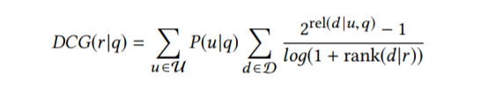


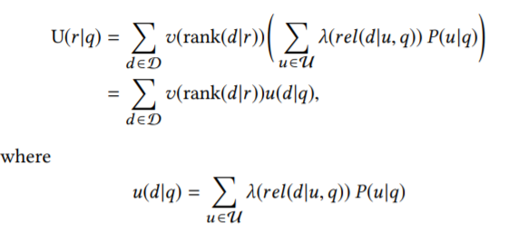
To incorporate the standard DCG metric in our framework:
where and
Notes:
we can write utility as
Here v is based on position bias i.e. the fraction of users who examine the document shown at a particular position out of the total number of users who issue the query q.
The choice of λ mapping relevance to utility is arbitrary.
Here we are combining the individual utilities to form the expected utility of a document d for query q

Slide 15

In case of binary relevance and λ as the identity function, u(d|q) is equivalent to the probability of relevance. Thus on sorting the documents by u(d|q) will generate the ranking that will maximize the utility for any function v that decreases with rank. (Probability ranking principle)

Slide 16
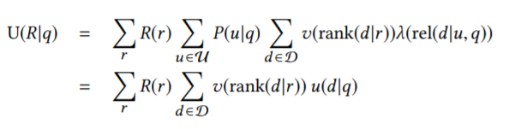
Probabilistic Rankings
If we search for utility-maximizing ranking under fairness constraints, then we will have to naively search for the complete ranking space which will take time exponential in |D|. Thus we are considering probabilistic rankings R instead of a single deterministic ranking r. R is a distribution over rankings.
Notes:
While distributions R over rankings are still exponential in size, we can make use of the additional insight that utility can also be computed from the marginal rank distributions of the documents.

Slide 17
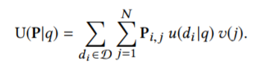

Let P_{i,j} be the probability that R places document d_{i} at rank j, then P forms a doubly stochastic matrix of size N × N, which means that the sum of each row and each column of the matrix is equal to 1. In other words, the sum of probabilities for each position is 1 and the sum of probabilities for each document is1.
u_{i} = u(d_{i} | q) and v_{j} = v(j). In matrix multiplication, utility can be written as
Notes:
u(d_{i} | q) is basically the a combined relevance of the document i given the query by different users. V was our position bias.

Slide 18
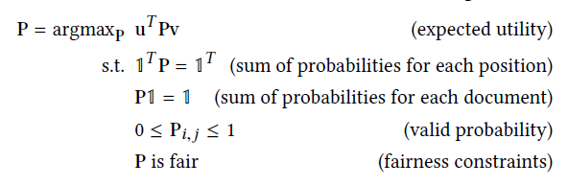

Optimizing Fair Ranking via Linear Programming
Notes:
This is what we have computed so far as the problem of finding the utility- maximizing probabilistic ranking and this is linear. Matrix P has N square values so our optimization objective is linear in N square. The constraints ensuring P as doubly stochastic are also linear. So far our framework can be considered as a linear program and now we can introduce our linear fairness constraints of the form
Vectors f and g and scalar h will be chosen according to different fairness constraints, explained after this framework.
f will be used to encode the group identity or relevance of each document while g will be used as position bias.

Slide 19
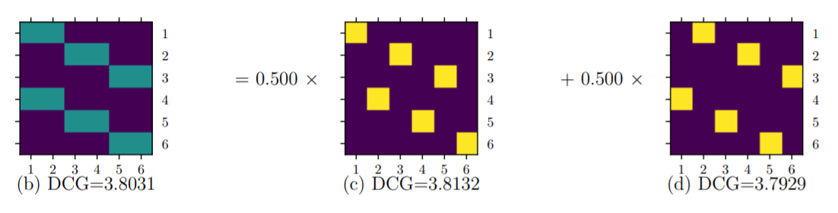
Sampling Rankings
We need to compute ranking R from our doubly stochastic matrix P and then sample r from R to present to the user.
To compute R from P, we will use here Birkhoff-von Neumann decomposition.
The permutation matrices correspond to deterministic rankings of the document set and the coefficients correspond to the probability of sampling each ranking.
Notes:
Author also mentioned that we make the sampling in a pseudo random based on hash of a user’s identity so that same user gets same ranking r if the same query is repeated.

Slide 20
Summary of Algorithm
Assumption: the knowledge of the true relevances u(d|q) (more in discussion)
(1) Computing the utility vector u, the position discount vector v, as well as the vectors f and g, and the scalar h for the fairness constraints .
(2) Solve the linear program for P.
(3) Compute the Birkhoff-von Neumann decomposition P = θ₁P₁ + θ₂P₂ + · · + θ_{n}P_{n}.
(4) Sample permutation matrix P_{i} with probability proportional to θ_{i} and display the corresponding ranking r_{i} .
Notes:
the rankings sampled in the last step of the algorithm fulfill the fairness constraints in expectation, while at the same time they maximize expected utility

Slide 21

Constructing group fairness constraints
We will construct our group fairness constraints on two examples
Job-seeker example
News recommendation dataset
Notes:
Now we have the framework defined in the previous slide, we can establish the fairness constraints of the form f ^{T} Pg = h.
we define exposure for a document d_{i} under a probabilistic ranking P as summation over all documents from j =1 to N as a product of P_{ij} and V_{j}, where P_{i,j} be the probability that R places document d_{i} at rank j and v represent the importance of position j. Our goal here is to allocate exposure fairly between groups G_{k} . This formula of exposure will be used in future slides. For experiments, the author is using two example.
Job - seeker example as explained in the motivation section
News recommendation dataset to analyze the method on larger and real world relevance distribution (Yow News)
-------------------------------------------------------------------------------------------------------------------------------------------------------
About dataset: The dataset contains explicit and implicit feedback from a set of users for news articles from different RSS feeds. We randomly sample a subset of news articles in the “people” topic coming from the top two sources. The sources are identified using RSS Feed identifier and used as groups G0 and G1. The ‘relevant’ field is used as the measure of relevance for our task. Since the relevance is given as a rating from 1 to 5, we divide it by 5 and add a small amount of Gaussian noise (ϵ = 0.05) to break ties. The resulting ui are clipped to lie between 0 and 1.

Slide 22
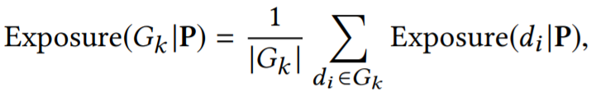
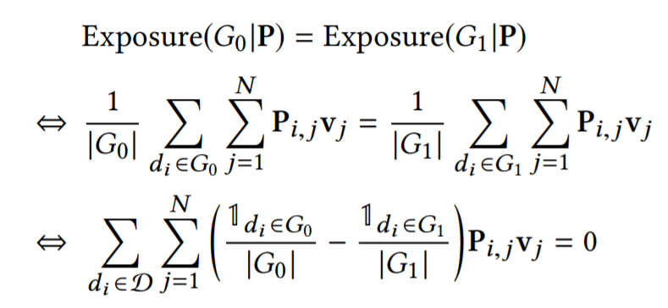
Demographic Parity Constraints
Notes:
As we defined exposure in previous slide, this is the formula for exposure of a group averaged over the number of items belonging to group k.
The simplest way of defining fairness of exposure between groups is to enforce that the average exposure of the documents in both the groups is equal.
we obtain a constraint in the form f ^{T} Pg = h which we can plug it into the linear program defined in the algorithmic framework.
This is called Demographic Parity Constraint but such a constraint may lead to a big loss in utility in cases when the two groups are very different in terms of relevance distribution and this we will see in next slide.

Slide 23
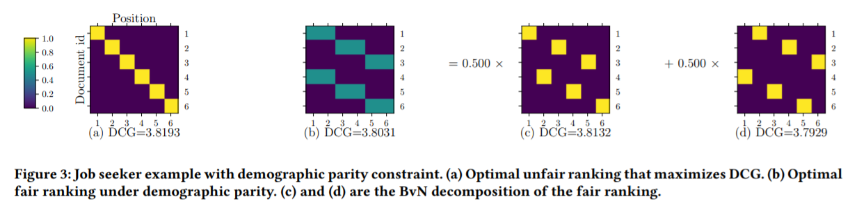

Experiment 1
Notes:
If you remember from the job seeker example, the first image is showing the P matrix without considering any fairness constraints. This is optimal unfair rank that maximizes utility only. The yellow colour means probability =1 of a1 person being ranked at first place. Similarly a2 is placed at second rank and thus the position [2,2] = 1 which means that ranking r places the person 2 at second place.
Figure b shows the optimal fair ranking with demographic parity constraint. The blue colour means probability value = 0.5. This new ranking will place either a1 or a4 at position 1 both with probability 0.5(i.e. equal), similarly a2 or a5 at position 2, giving equal exposure to both the groups. We can also see that in figure c and d, they are the birkhoff von neumann decomposition of matrix in figure b. The two possible probability matrices can be formed with equal probability of 0.5. the positions 1,3,5 are given to people from one group and 2,4,6 position is allotted to the other group to give both the groups equal exposure.
Compared to the DCG of the unfair ranking with 3.8193, the optimal fair ranking has slightly lower utility with a DCG of 3.8031.
One drawback of this approach is that it ignores the relevance For example, if we lowered the relevances for the female group to u = (0.82, 0.81, 0.80, 0.03, 0.02, 0.01) T , we would still get the same fair ranking as the current solution and the DCG will have a large drop.

Slide 24
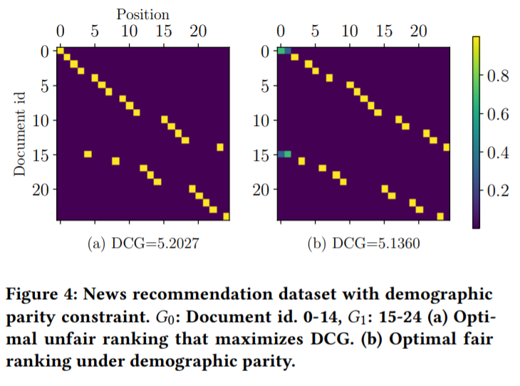
Experiment 2
Notes:
This experiment was done on news recommendation dataset with demographic parity constraint. in the first figure we can see that the documents belonging to G1 i.e. from 15-24 were starting from position 5 in unfair case and in figure b these documents were placed at either position 1 or 2 with equal probability of 0.5 in the fair ranking. There is not much difference observed at later part of ranking.

Slide 25
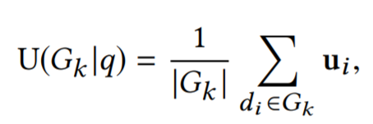
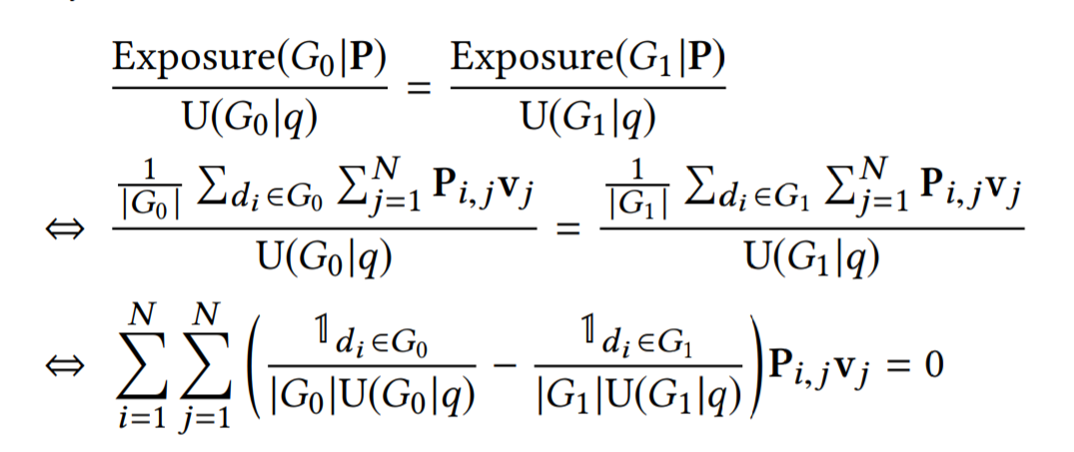
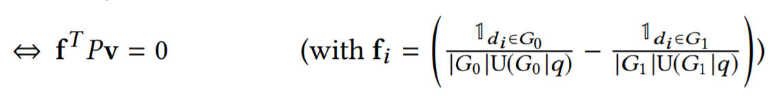
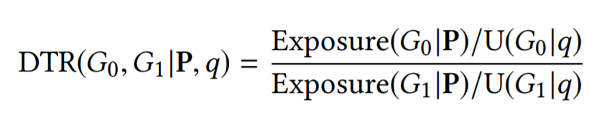
Disparate Treatment Constraints
Notes:
Demographic parity constraint is only considering equal exposure to the groups thus they have introduced this new fairness constraint which enforces exposure of the two groups to be proportional to their average utility. They have defined utility as Utility of group Gk given query q = summation of all the utilities of item i belonging to group k divided by total number of items present in that group. The ratio of exposure of group K given P is proportional to ratio of Utilities of group k given q for k = 0 and 1.
Disparate Treatment Ratio (DTR) to evaluate how differently the two groups are treated. DTR = 1 if the above explained constraint is fulfilled. The value less than 1 or greater than 1 tells which group out of G0 or G1 is disadvantaged in terms of disparate treatment.
Moving on to the experimets

Slide 26
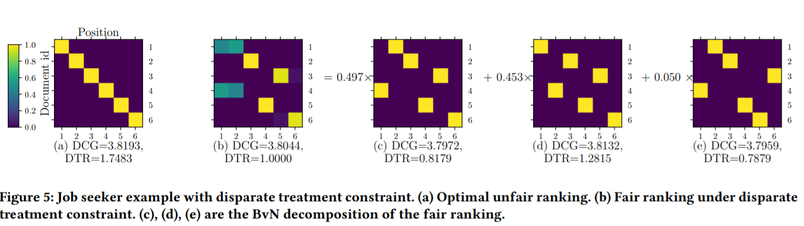
Experiment 1
Notes:
For Job seeker example, figure a shows optimal unfair ranking and we can also observe that DTR value is quite high here. Figure b shows the fair ranking under disparate treatment constraint. We can see that value of DTR is 1 here. figure c,d,e are three BnV decompositions of the fair ranking.
Though the value of DCG is lower in figure b than the DCG in figure a but if we compare the DCG of fair ranking under disparate parity constraint and disparate treatment, then DCG value is slightly improved here.

Slide 27
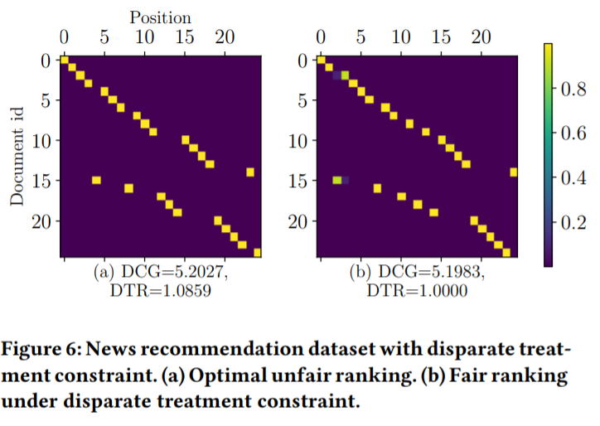
Experiment 2
Notes:
Here in News recommendation dataset, we can observe that there is a very slight drop in DCG of about 0.0044 when we are considering the ranking with DTR = 1.

Slide 28
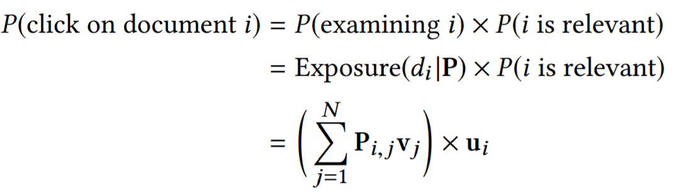
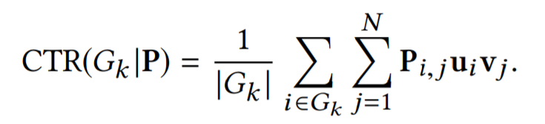
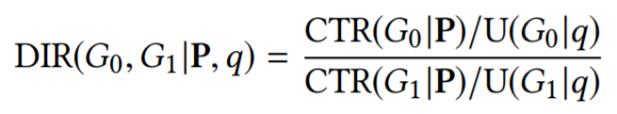
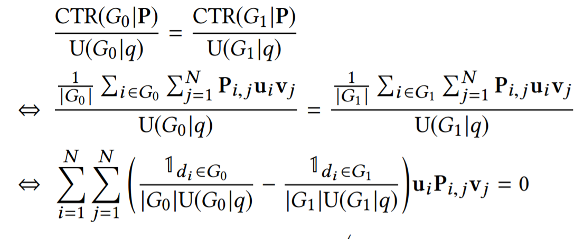
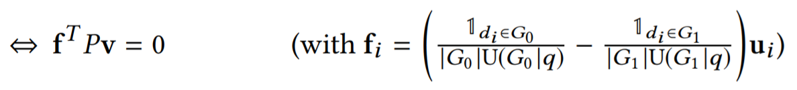
Disparate Impact Constraints
Notes:
The motivation as defined by the author behind treatment and impact is coming from the recommendation system. Where recommending or exposing an item is considered as treatment and user’s click or purchase is considered as the effect of the treatment or impact. Here we want to assure that the clickthrough rates for the groups as determined by the exposure and relevance are proportional to their average utility.
First we will define the probability that a document is being clicked as product of the document being seen by the user and the document being relevant. So the probability of document being examined is proportional to the exposure thus we got this formula for probability of click on document i as ….
The average clickthrough rate of documents in group k is computed as the summation of probability of click on all documents i belonging to group k divided by number of documents in group k.
So according to the Disparate Impact Constraint, the expected clickthrough rate of each group is proportional to its average utility. So if we simplify the terms, we again get the constraint in the form of f^{T} Pv that we can fit in our linear programming framework.
Now to measure the extent of violation of disparate impact constraint, the author defined Disparate Impact Ratio (DIR) as….
This ratio is equal to one if the disparate impact constraint is fulfilled and the value of DIR, less than 1 or greater than 1 tells which group is disadvantaged in terms of disparate impact.

Slide 29
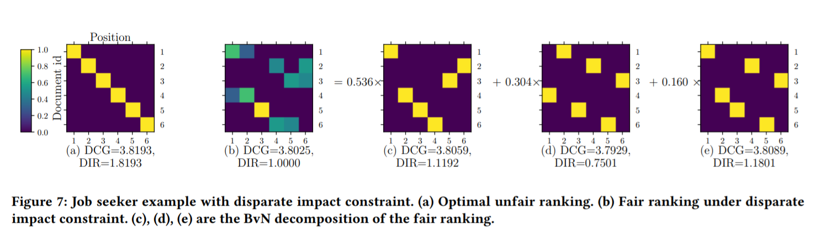
Experiment 1
Notes:
So coming again to our job seeker example, here we can see quite a large improvement in the Disparate impact ratio from unfair which is 1.8193 to fair ranking which is 1 with a slight drop in DCG from 3.8193 to 3.8025. Figure c,d,e are BnV decomposition of the fair ranking.

Slide 30
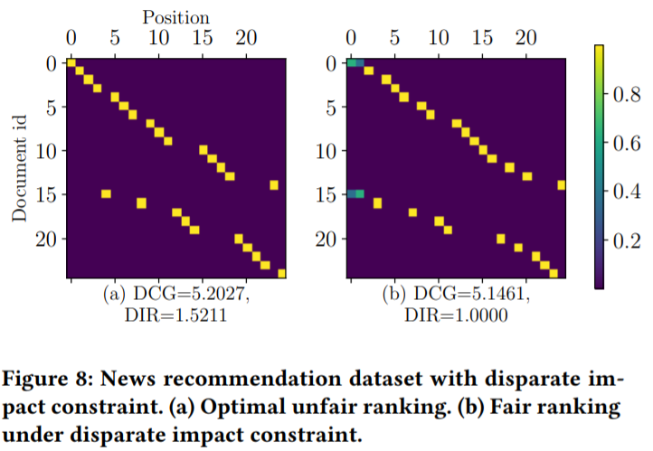
Experiment 2
Notes:
Here also in news recommendation dataset, we can observe a large improvement in DIR from 1.5211 to 1. This DCG of 5.1461 is lower than the unconstrained DCG which is 5.2027 and the DCG with disparate treatment constraint which was 5.1983, but higher than the DCG with demographic parity constraint which was 5.1360 .

Slide 31
Discussion
Fairness in rankings is inherently a trade-off between the utility of the users and the rights of the items that are being ranked, and that different applications require making this trade-off in different ways.
The author created a flexible framework that covers a substantial range of fairness constraints. and thus we can define more than just these 3 constraints based on different application.
Notes:
Few points that the author mentioned about this framework and the constraints are as follows:
fairness in rankings is inherently a trade-off between the utility of the users and the rights of the items that are being ranked, and that different applications require making this trade-off in different ways.
Example: one may not want to convey strong rights to the books in a library when a user is trying to locate a book, but the situation is different when candidates are being ranked for a job opening.
----------------------------- To the book example, if we consider a music library instead or a social media platform where we have so many content creators these days, their content is being recommended to us in our news feed and they would also want their content to have a fairness constraint so that not only one person who is already famous, keep getting more famous and new content creators with less followers does not get enough chance in terms of exposure to rise up.
The author created a flexible framework that covers a substantial range of fairness constraints. and thus we can define more than just these 3 constraints based on different application.

Slide 32
Group fairness vs. individual fairness
Individual items within a group might still be considered to suffer from disparate treatment or impact
We can include additional fairness constraints for sensitive attributes, like race, disability, and national origin within the group to refine the desired notion of fairness.
In the case of Disparate Treatment, we can express individual fairness as a set of N − 1 constraints over N groups of size one.
Notes:
In experiments, we observe that even though the constraints ensure that the rankings have no disparate treatment or disparate impact across groups, individual items within a group might still be considered to suffer from disparate treatment or impact.
We can include additional fairness constraints for sensitive attributes, like race, disability, and national origin within the group to refine the desired notion of fairness.
In the case of Disparate Treatment, we can express individual fairness as a set of N − 1 constraints over N groups of size one.

Slide 33
Using estimated utilities
We assumed that we have access to the true expected utilities (i.e. relevances) u(d|q).
In practice, these utilities are typically estimated via machine learning and thus are subject to some other biases that may lead to biased estimates û(d|q).
Biased estimates might be the result of selection biases in click data.
But as we have seen in our last presentation by Nishtha, with counterfactual learning techniques we can get unbiased ranking despite of biased click data.

Slide 34
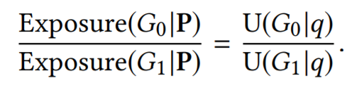
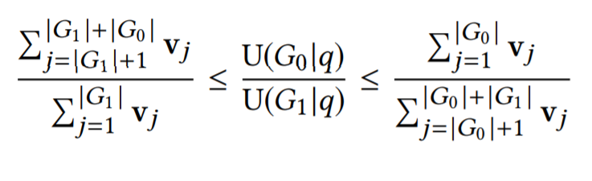
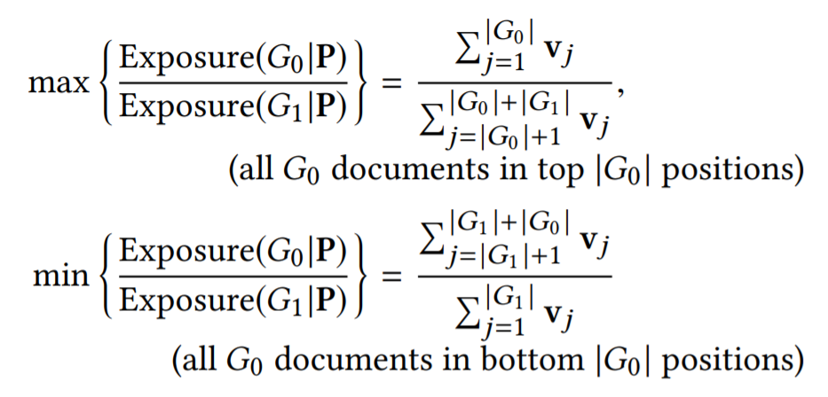
Cost of fairness
Feasibility of fair solutions
CoF = u^{T} (P* − P)v
Notes:
The loss in utility can be computed as CoF = uT (P∗ − P)v, where P∗ is the deterministic optimal ranking, and P represents the fair ranking.
Consider the disparate treatment constraint. We can adversarially construct an infeasible constraint by choosing the relevance so that the ratio on the RHS lies outside the range that LHS can achieve by varying P. The maximum of the RHS occurs when all the documents of G0 are placed above all the documents of G1, and vice versa for the minimum. These are our two extreme rankings.
Hence, a fair ranking according to disparate treatment only exists if the ratio of average utilities lies within the range of possible values for the exposure
In such a case the constraint can still be satisfied if we introduce more documents belonging to neither group (or the group with more relevant documents). This increases the range of the LHS, and the ranking doesn’t have to give undue exposure to one of the groups.

Slide 35
Conclusions
In this paper, a general framework has been developed that employs probabilistic rankings and linear programming to compute the utility-maximizing ranking under a whole class of fairness constraints.
To verify the expressiveness of this class, author demonstrated the concepts of fairness through demographic parity, disparate treatment, and disparate impact.
We conjecture that the appropriate definition of fair exposure depends on the application, which makes this expressiveness desirable.

Slide 36
Disparate treatment is intentional, where one is treating an individual “unfairly on account of membership in a protected class, such action relates to intent and maps onto disparate treatment doctrine.” For example, if your company is requiring assessments on particular skills for certain minority group applicants, it would be considered as disparate treatment.
Disparate impact is unintentional discrimination, where “the system treats someone unfairly [and] it is not necessarily because any person intended such a result.”For example, if your company uses technology or system that results in a disproportionate treatment “directed at a protected class, such as race, gender, age, disability, or in some cases, sexual orientation,” then we have a disparate impact present.

Slide 37
Questions
Can the ranking distribution matrix model be extended to an N*K scenario, where we only care about rankings till K, instead of wanting to rank the entire list of documents?
Yes, I think this is possible to only compute rankings till top K. we just require to compute P_{i,j}, whose elements represent probability that R places document d_{i} at rank j, then P forms a doubly stochastic matrix of size K x K, instead of N × N.
Notes:
It just won’t be N x K but K x K. as we require a doubly stochastic matrix for our framework and also if ranks are till k then we only require to rank k documents for that.

Slide 38
The Disparate Treatment problem, can we apply a squeezing function (for example, sigmoid) to the utility/relevance function? This would decrease the winner-take-all factor.
Here the values follow the standard probabilistic definition of relevance, where 0.77 means that 77% of all employers issuing the query find that applicant relevant.
Notes:
I dont really understand this question but the utility/relevance values are the probabilistic relevance values here. for eg if the relevance is 0.77 then it represents that 77% of all employers/users issuing the query, find that applicant/item relevant.

Slide 39
Explain the process surrounding BvN decomposition and what the figures from the experiments show?
Can complex clickthrough estimation model be also reduced to linear constraints?
How much is the probability of getting no feasible solution when the data is increased? Is adding extra documents (as discussed by authors) the only solution?
So if we take our job seeker example here, we have 6 candidates, thus only 6 ranks are possible.
v(j) = 1 / Log (1+j) thus v(1) = 3.21, v(2)=2.095, v(3) = 1.660, v(4) = 1.430, v(5) = 1.285, v(6) = 1.183

Slide 40
Maximum exposure = 7.076 / 3.898 = 1.815
Minimum exposure =3.898 / 7.076 = 0.0550
u = (0.81, 0.80, 0.79, 0.78, 0.77, 0.76)
= 0.80/0.77 = 1.03, thus feasible
but if we consider relevance as = (0.82, 0.81, 0.80, 0.03, 0.02, 0.01)
= 0.8/0.02 = 40, Out of range and thus not feasible
Here as exposure depends on the v(j) for feasibility, we have to add more documents only to increase the value of max exposure possible.
Notes:
I could not think of other possible methods but if somebody else has an idea then we can discuss it here.

Slide 41
How do you account for the bias that comes from the ranking model itself - maybe some kind of ML model? The paper assumes that we have the true relevance score but in practice it would come from some ranking model.
So there are some possible sources of bias like bias in the training data, bias in user behaviour through click data, etc.
To account for the second type of bias which arises through clicks and user feedbacks, we have seen in our last presentation by Nishtha, that with counterfactual learning techniques we can get unbiased ranking despite of biased click data.

Slide 42
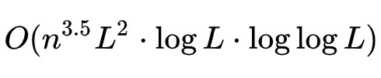
Time complexity analysis of the algorithm in section 3.3
In section 3.3 we got a linear program which can be solved using Interior-point method as mentioned in the paper as well. There is a polynomial time algorithm called Karmarkar’s Algorithm which can solve linear programming problem very efficiently. Its running time is
where n is number of variables and L is number of bits of input to algorithm.
Notes:
Karmarkar’s Algorithm for Linear Programming, Interior-point method

Slide 43
Is the BvN decomposition of matrix P unique? If not, then there are probably many R functions that can satisfy a given linear programming problem and the paper chooses one arbitrarily. Is there scope for improvement here? Can it be better to break ties more smartly?
BvN decomposition of a doubly stochastic matrix may not be unique - both in terms of permutation matrices used and also in the number of matrices used to produce such a decomposition.
A new paper is under review for ICLR 2021 which proposes a new algorithm
Approximate Birkhoff-von-Neumann decomposition: a differentiable approach
The author claims this to be an improvement over previous greedy methods to solve BnvD and this paper considers our paper of today, fairness in exposure of ranking to explain its approach
https://openreview.net/pdf?id=IpsTSvfIB6

Slide 44
How big is the dataset on which they experiment?
Around 8000 documents
https://users.soe.ucsc.edu/~yiz/papers/data/YOWStudy/

Slide 45
Reviews
Overall everyone found the paper easy to understand.
There were few concerns regarding the scalability of the framework as the matrix method store N² values, so the space complexity will be high if N is large.
Also if add more constraints to refine the fairness against discrimination of not only gender but race, disability, etc then how the complexity of algorithm changes and how will the formulas be formulated in that sense.
The dataset taken was very small and does not reflect the feasibility of algorithm in real world online setting.
Notes:
To my understanding of this point, author mentioned the extension to individual fairness if we consider N groups of size 1 each. and the constraints mentioned were N-1. so first they are computing wrt to 2 constraints, then in cooperation the 3rd constraint to that ranking.

Slide 46
References
Selbst, Andrew D. “Disparate Impact in Big Data Policing: Published in Georgia Law Review.” Georgia Law Review, 19 Feb. 2018
A Tutorial on Fairness in Machine Learning | by Ziyuan Zhong
YOW User Study Data: Implicit and Explicit Feedback for News Recommendation
MilkaLichtblau/BA_Laura: Fair Benchmarks

Slide 47
Thank You

